Slide 1
Bananoz Shopping Site
Prepared By: Vishal Pundalik Sonar

Slide 2
INTRODUCTION
Bananoz is one of the fastest-growing fashion influencing website in which people sell their products with the help of other people.
The great thing about Bananoz is that your store will be promoted by hundreds of Bananoz's members.
After signing up - your store will be created automatically . Your job is to choose the best 25 items from the website and to upload them to your store . You'll earn 15% for any of these items that will be sold.
After signing up - your store will be created automatically . Your job is to choose the best 25 items from the website and to upload them to your store . You'll earn 15% for any of these items that will be sold.

Slide 3
DESCRIPTION OF THE PROJECT TITLE
Bananoz is a very important used in e-commerce to assist people creating their own online store and promoting their products.
Influencers can come from a wide range of places,any individual, group, brand, or place could potentially be an influencer and promote their products.
More and more business houses are implementing web site providing functionality for performing commercial transactions over the web. It is reasonable to say that the process of shopping on the web is becoming commonplace.

Slide 4
LITERATURE SURVEY/BACKGROUND STUDY
Our team found that the UI/UX of the old website was outdated and sluggish.
The company already had a shopify-based e-Commerce website and asked to make it attractive and trendy.
During our research, we also found that the overall performance of the old website was slow due to several bugs and errors.
In the previous website, users cannot add information regarding their personal portfolios and websites.
Users were unable to share photos and reviews of purchased items on the website.

Slide 5
PROBLEM STATEMENT
In this project, we will be designing a simple and user friendly application in which user can sell or buy the product on single signup by following some basic registration.
User can check cart, orders and also promote other products ,By promoting the product user get some amount on the selling of the product which is promoted by the user.
User Control Panel shows the record of promotion commission, user own product selling income and all Earning report which can be filter with the month and year also.

Slide 6
SCOPES AND OBJECTIVES
Our proposed solution is to revamp the website for client to stand out in competition.
Update it with new feature so that users can also upload photos of purchased items and write their honest reviews of the same.
We are going to add a feature in which influencers can add their personal website link to their Bananoz store.
Redesign existing website to make it more attractive and user-friendly.
Add some graphics to enhance the overall look of the website.
A feature where in a store is automatically created once the user register to the Bananoz website.

Slide 7
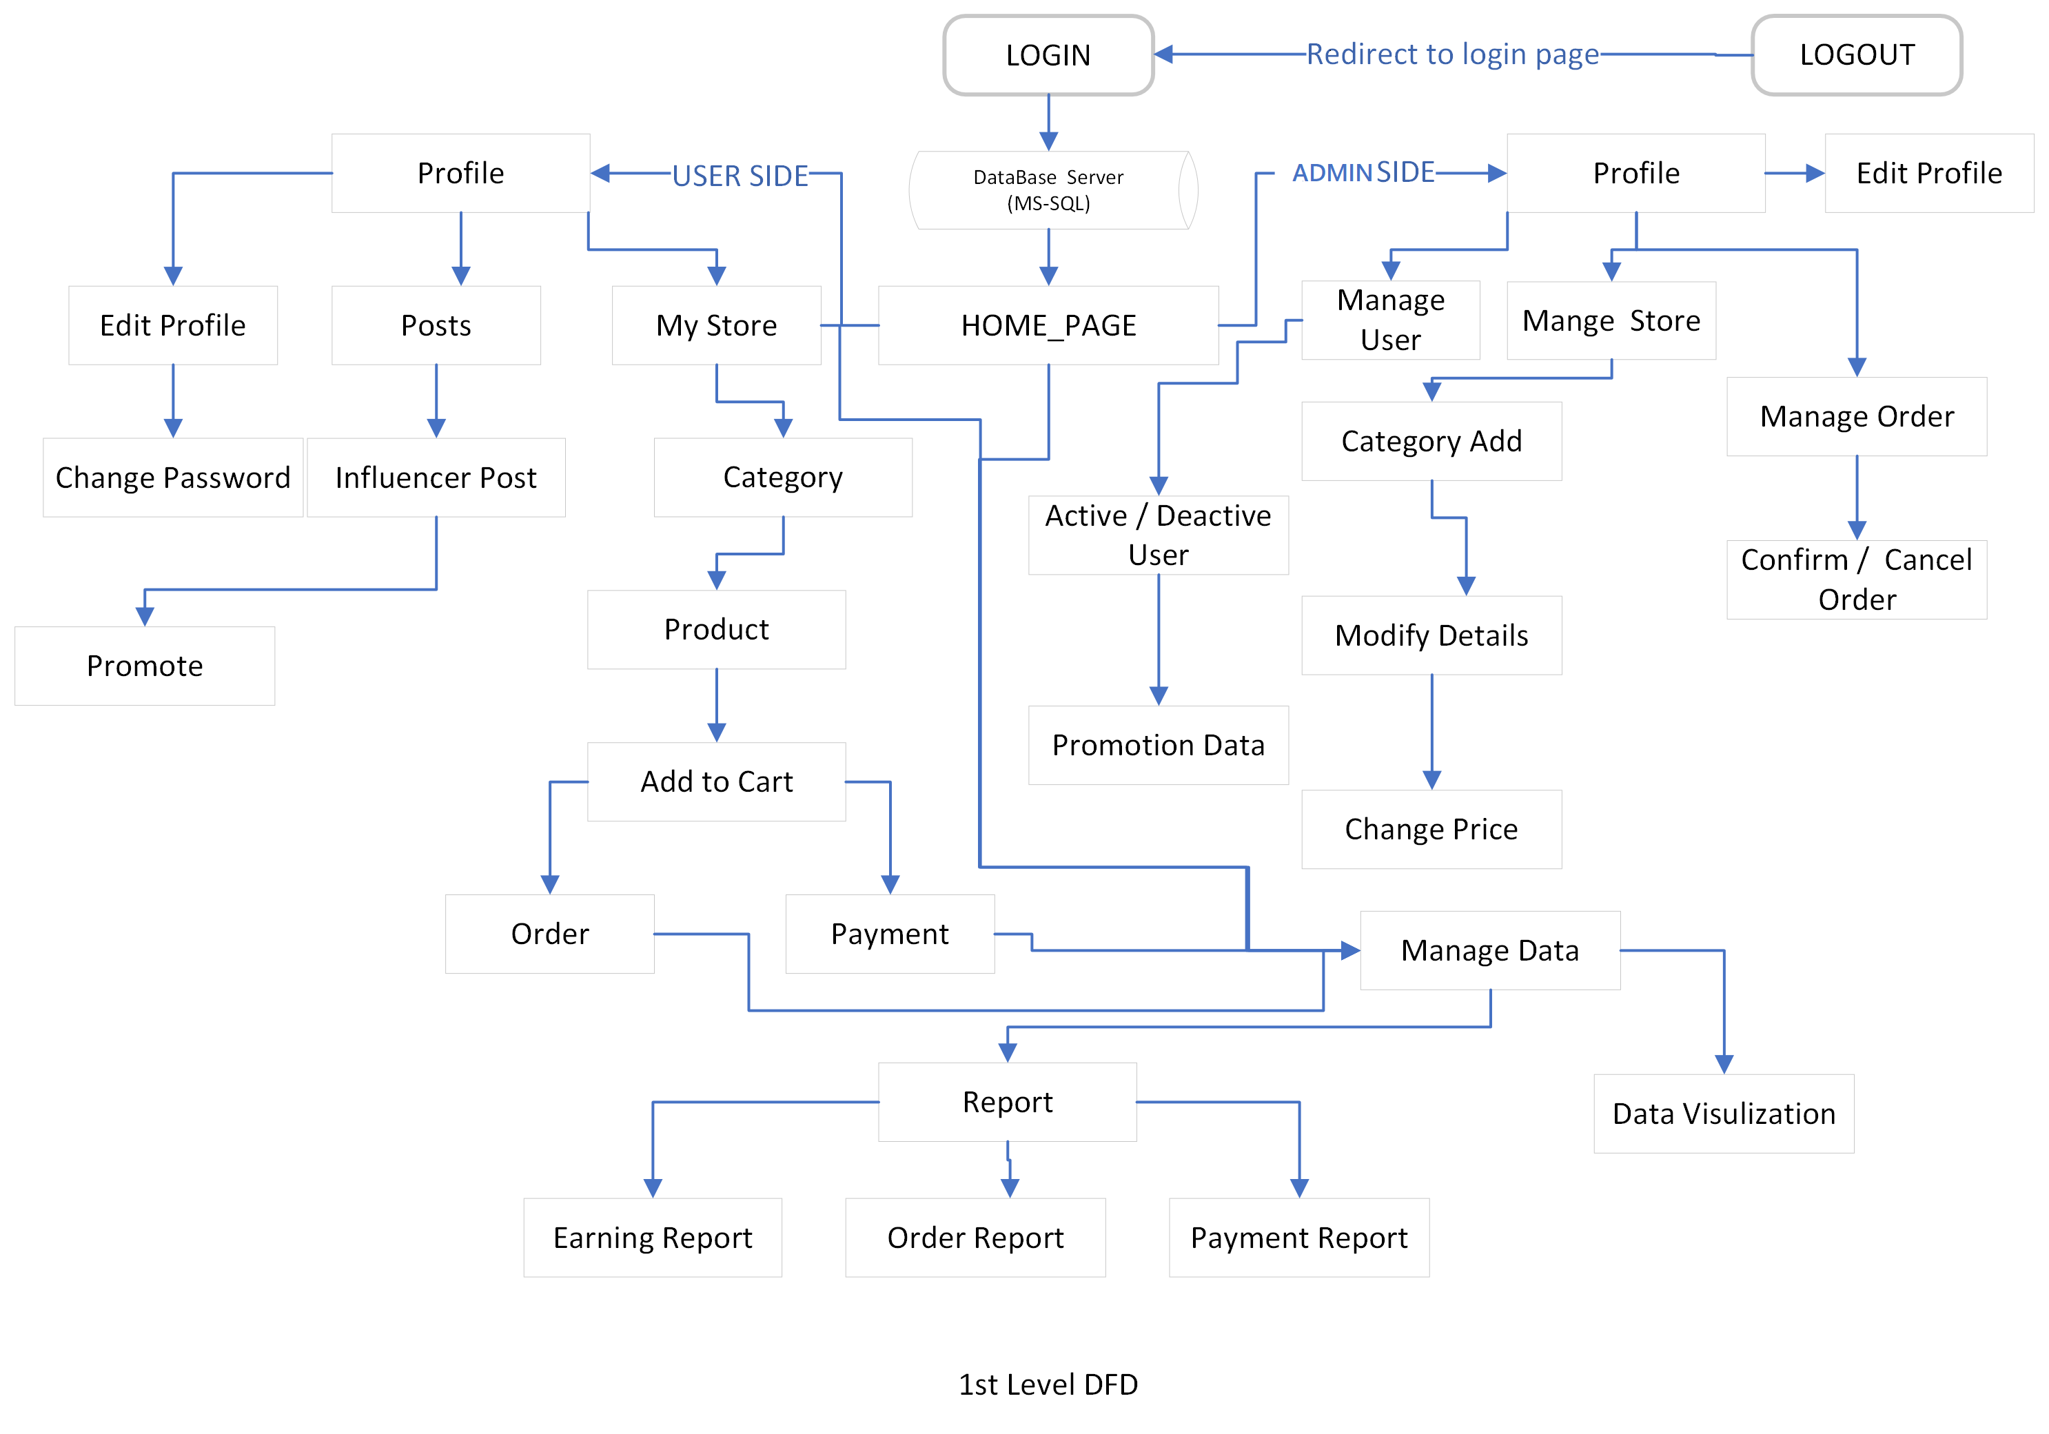
Flow Chart

Slide 8
Description of modules in your system
Using the latest technologies such as Python and ReactJS, team at KCS redeveloped the Bananoz website.
Redesigning the website using ReactJS enhance the overall look of the website.
We also resolved all the bugs and errors and made the Bananoz website speedy.
Using Data Visualization tools and
Using the Python language, we developed several features that will help the company to stand out from the competition.

Slide 9
System Analysis
Old technologies used.
Several bugs and errors in the website.
Slow performance.
Less features.
Redesign the website to make it look modern and attractive.
Added new feature where in a store is automatically created once the user register to the Bananoz.

Slide 10
Tools and Technology for Implementation
Frontend :- React JS, HTML, CSS.
Backend :- Python.
Other :- PowerBI

Slide 11
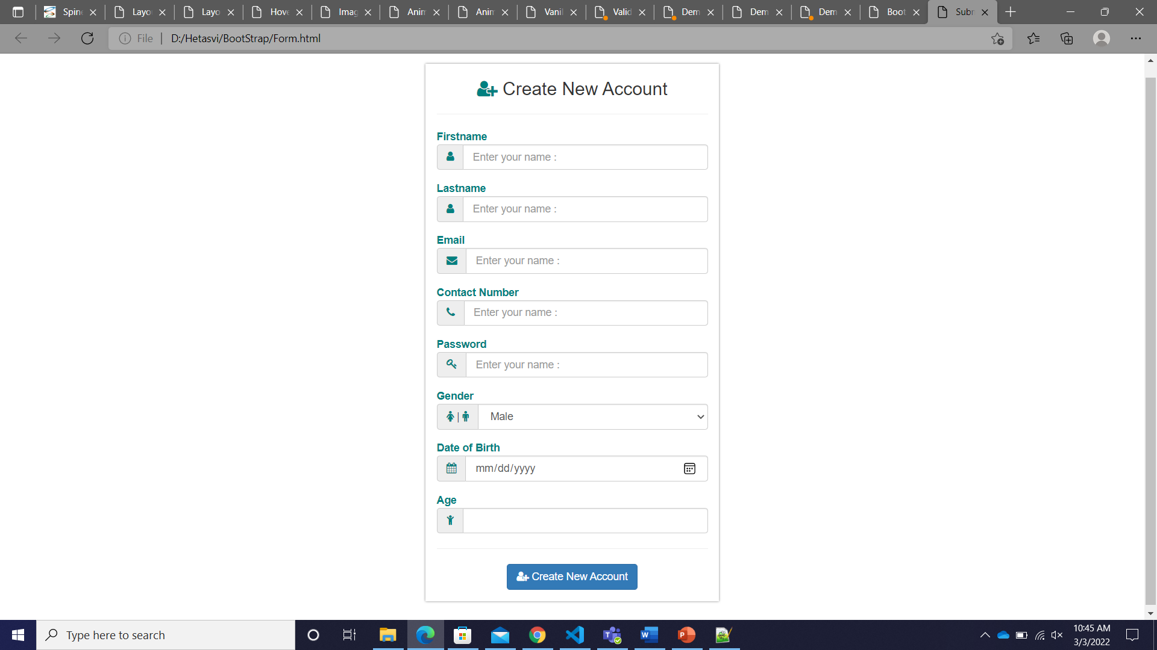
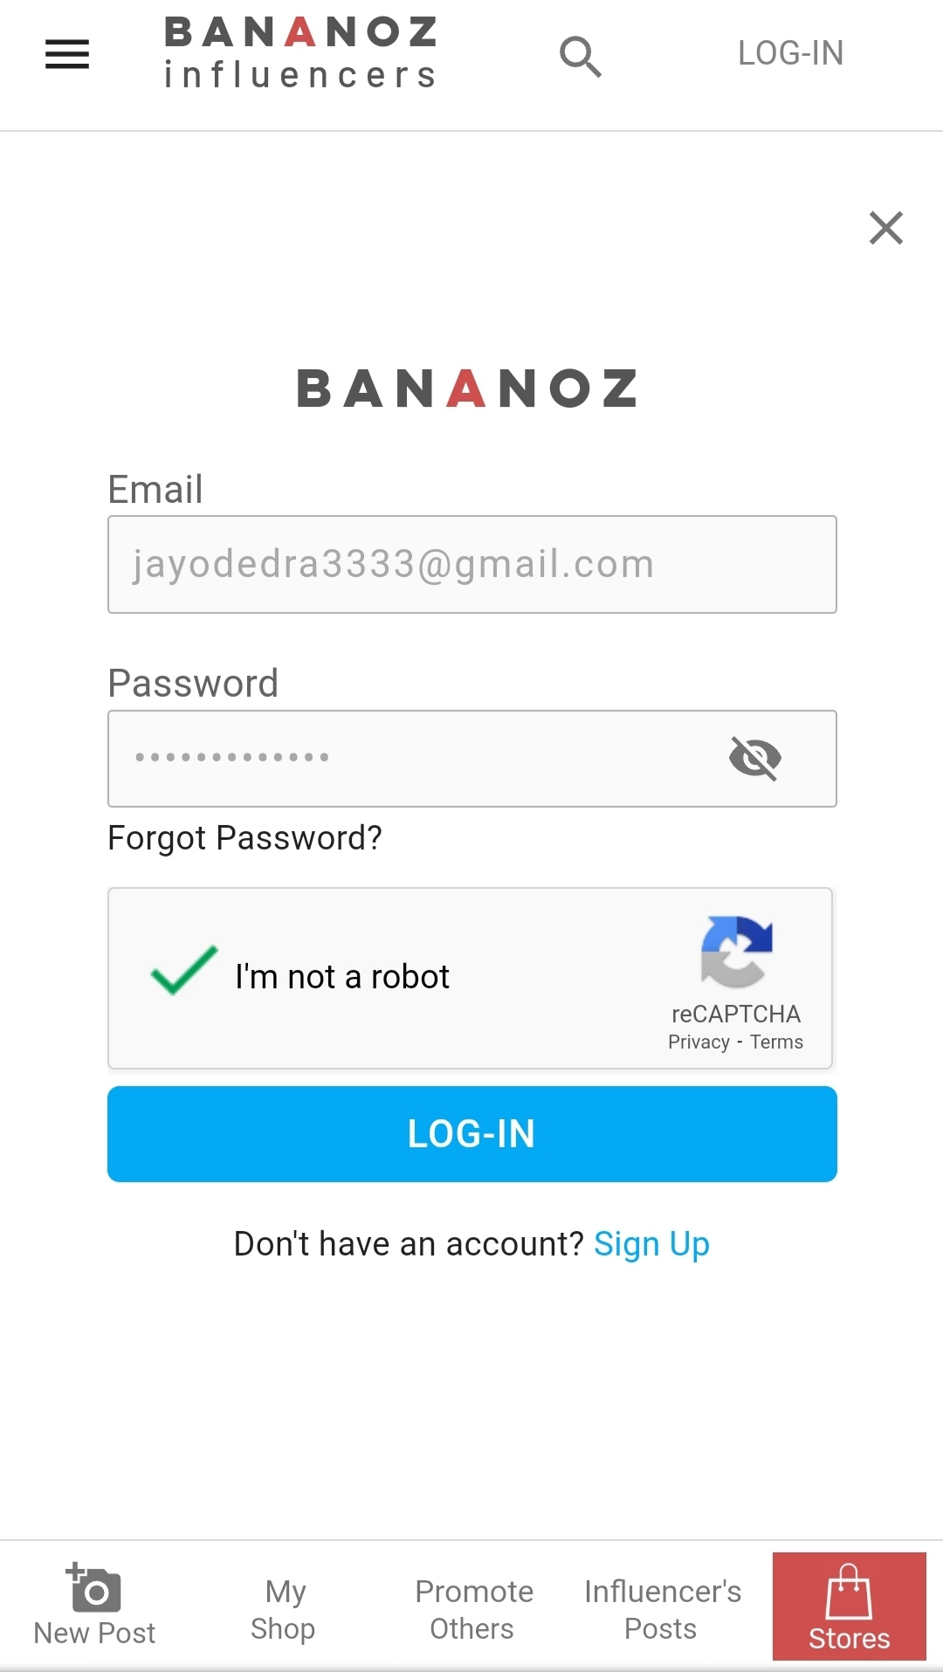
Comparison of the existing system with your proposed system
User Registration Sign-up:-
Demo Code Final implementation

Slide 12
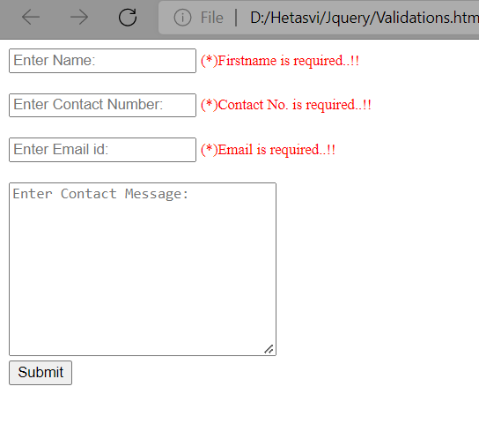
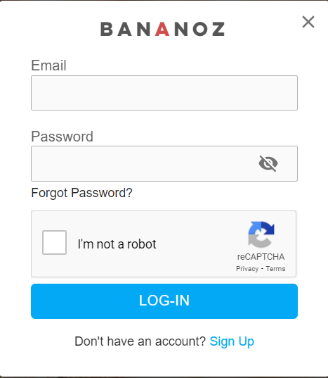
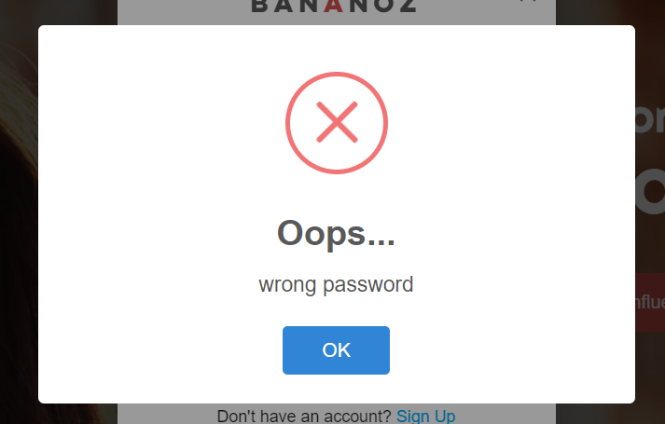
Comparison of the existing system with your proposed system
User log-in:
Practiced Code Final implementation with validation

Slide 13
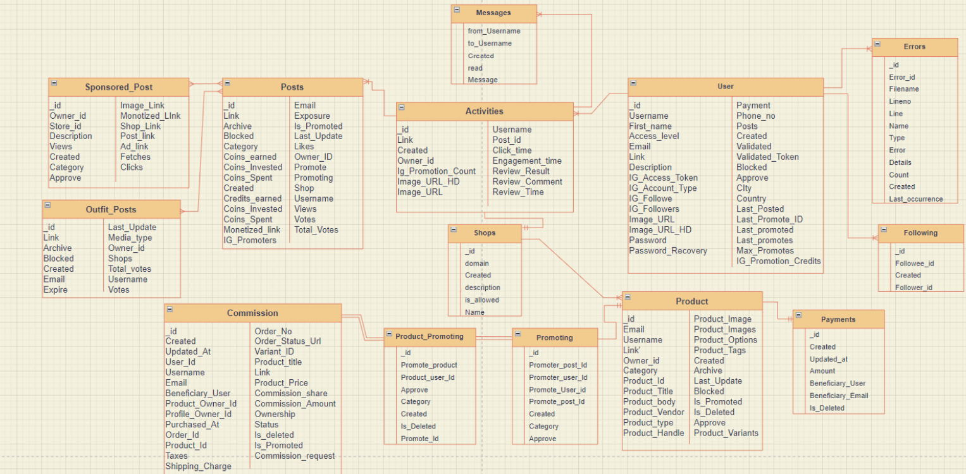
Database Chart

Slide 14
Learning Outcomes
I learned Data Gathering.
I learned to monitor data in real time.
I leaned new techs like PowerBI : I visualize data for client for better business dessions.

Slide 15
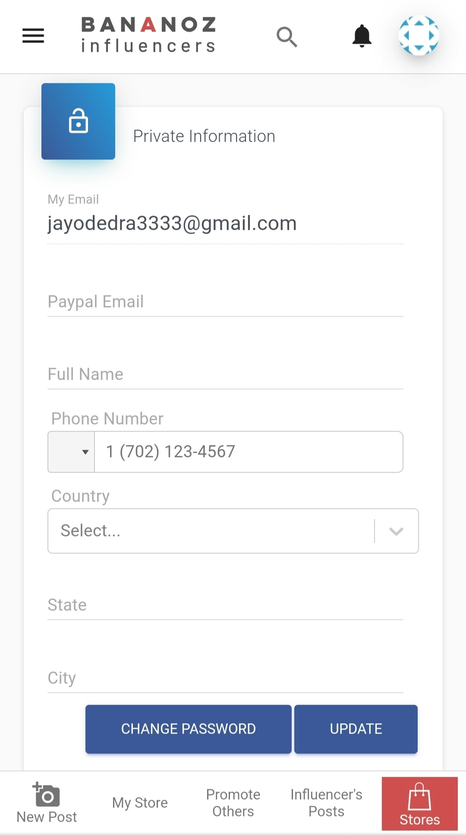
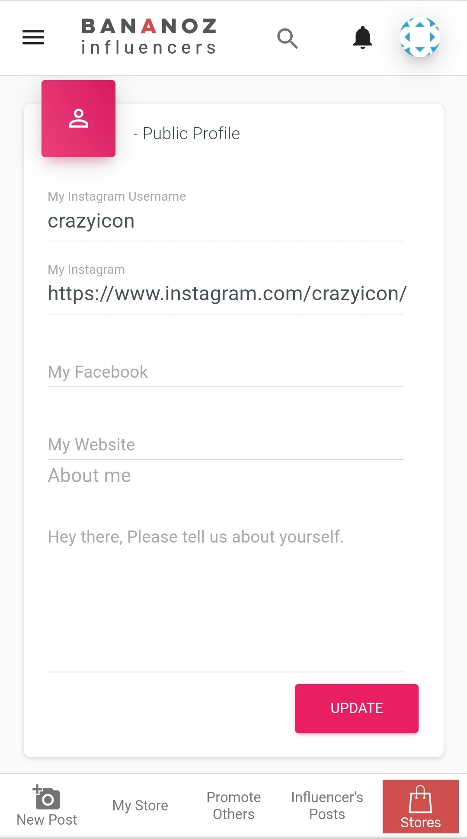

Implementation

Slide 16
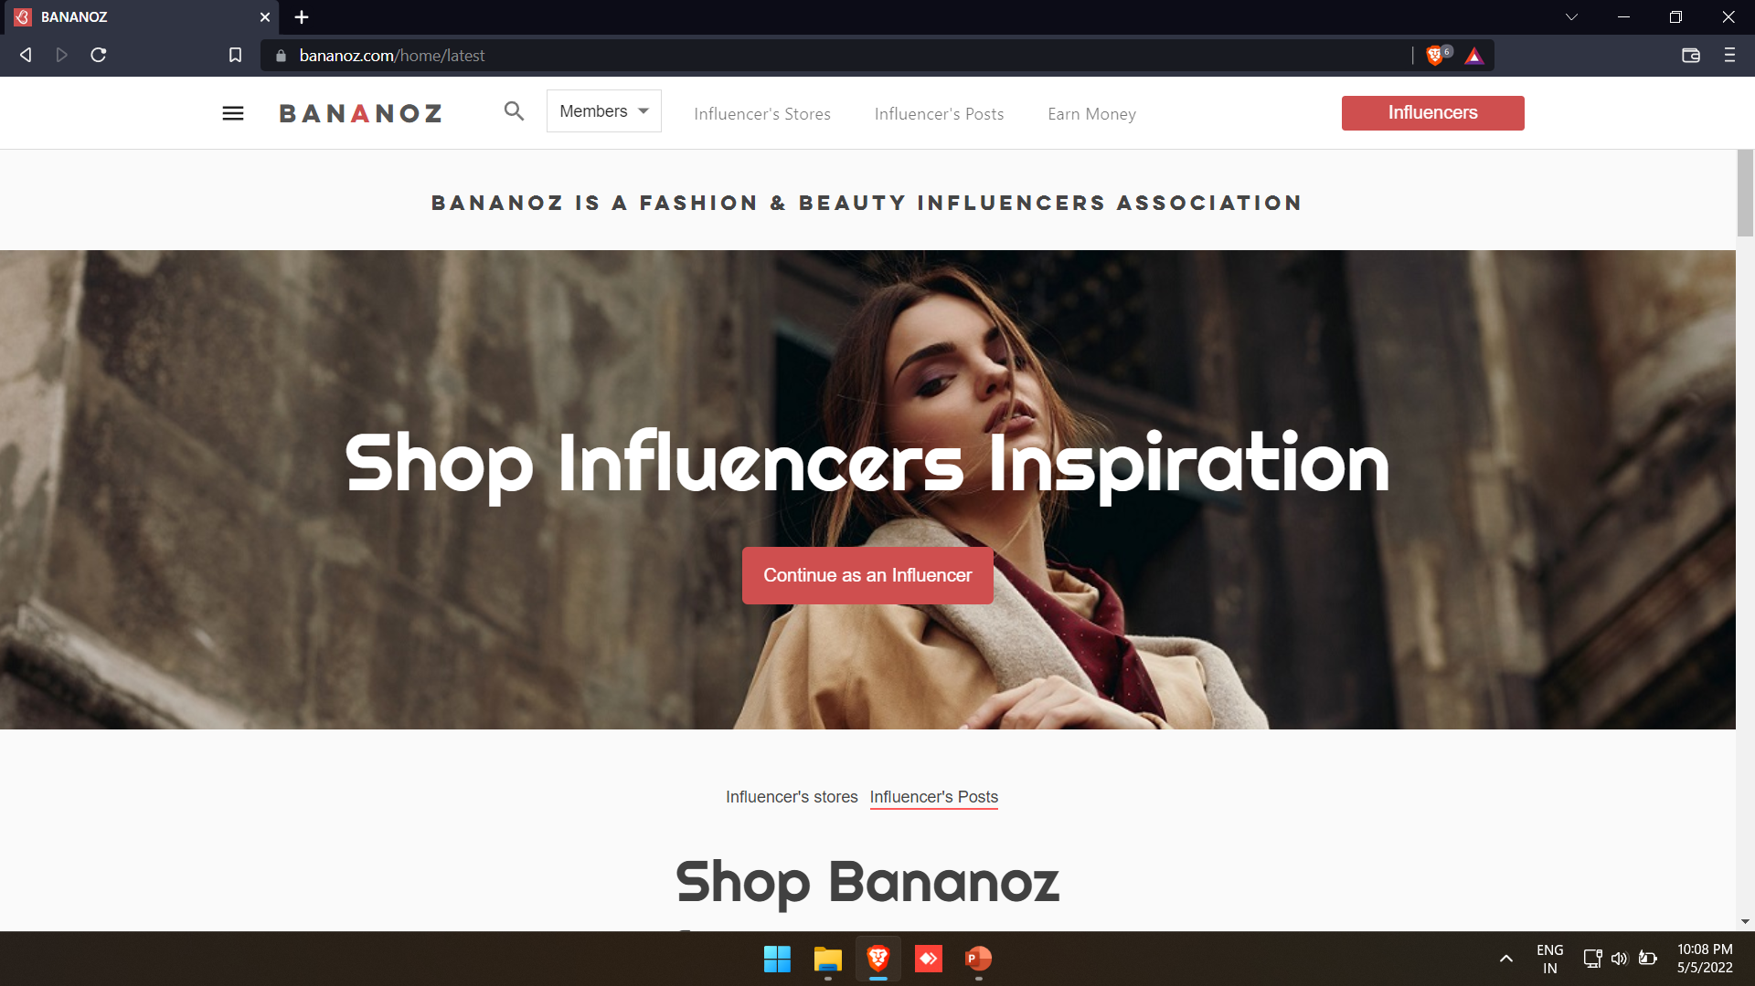
Implementation

Slide 17
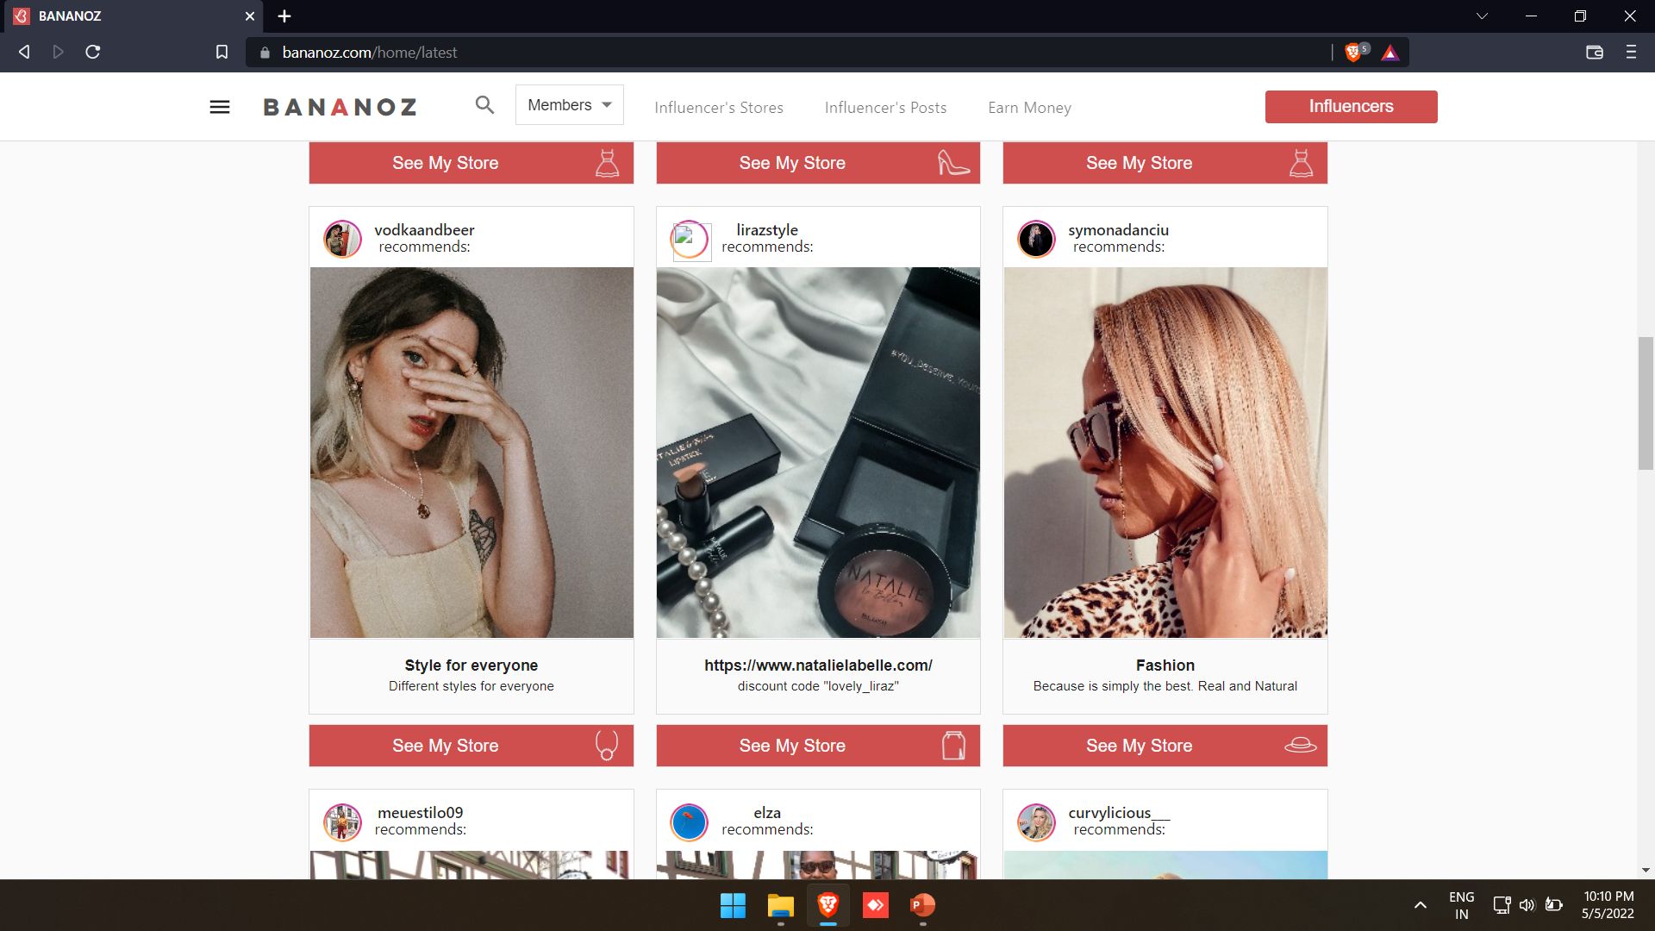
Implementation

Slide 18
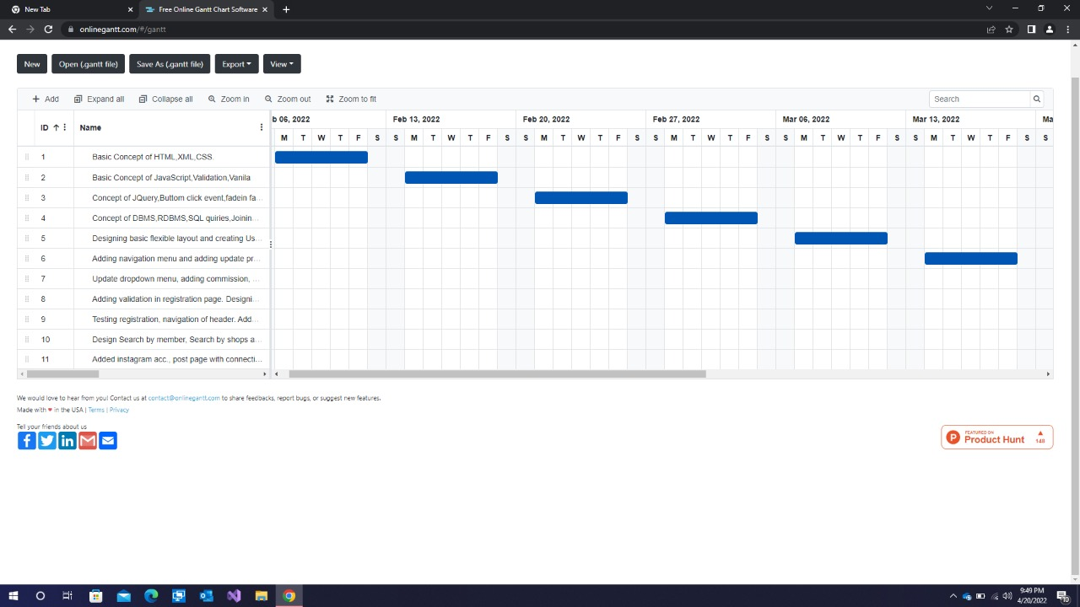
Timeline Chart

Slide 19
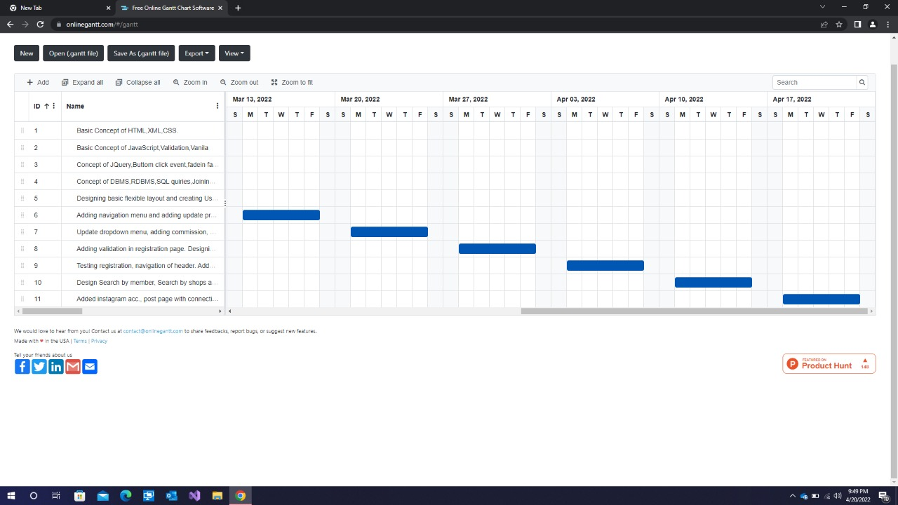
Timeline chart

Slide 20
Advantages
24/7 customer support
Each theme is also fully customisable by editing the code. So creating a beautiful and unique online shop that fits with your brand identity is simple!
Bananoz shopping site is a treasure trove of functionality that you can add to your shop. You can add reviews, social media intigration, customer wishlists.
The app store gives you access to a huge range of marketing tools including social media integration, product reviews and email marketing.

Slide 21
Limitations
Bananoz Shopping site doesn’t offer a mobile shopping app solution.
Sorting of products on frontend side is very limited.
You have to use third party apps for communicate with C2B.
Despite touting itself as an out-of-the-box eCommerce platform, Bananoz Shopping site provides considerably basic product search features.
Bananoz Shopping site doesn’t autocorrect product search results. Besides, unlike other advanced eCommerce platforms, Bananoz Shopping site stores don’t offer suggestions while a shopper starts typing a product name.

Slide 22
Future Scope
The Content Management System (or CMS) of Bananoz Shopping site doesn’t let business owners publish rich content like blogs or vlogs. Our team working on adding this feature.
Bananoz Shopping site search mechanism isn’t as efficient as it should be. In fact, a majority of users operating on Bananoz Shopping site platform aren’t content with the search solution that comes with out-of-the-box version of Bananoz Shopping site .

Slide 23
Conclusion
The objective of this project was to develop a general-purpose e-commerce store where any product can be bought from the comfort of home through the Internet and to sell their products with the help of people from all over the world using famous social media “Instagram”.
The website is to promote various products such as shirts, t-shirts, shoes, accessories, etc. for both men and women.

Slide 24
REFERENCES
https://www.academia.edu
https://logojoy.com
www.lucidchart.com
www.scribd.com
https://www.slideshare.net/

Slide 25
Thank you

